Slide 1
Functional tests automation in practise – Robot Framework
Paweł Nogieć
26-05-2025

Slide 2
How do we do it at Nokia?

Slide 3
Robot Framework
Why robot
Easy-to-use tabular syntax for creating test cases in a uniform way
Ability to create reusable higher-level keywords from the existing keywords
Easy-to-read result reports and logs in HTML format
Is platform and application independent
Simple library API for creating customized test libraries
Well documented
Notes:
Dlaczego warto uzywac robota ?
Jest łatwy
Nie wymaga duzego doswiadczenia programistycznego
Dobrze przygotowane keywordy sa czytelne
Z gotowych keywordow można przygotowac swoje nowe keywordy
Przyzwoity system logowania logowanie do html
Testy napisane na platformie linux powinny dzialac również na platformie windows
Posiada sporo bibliotek które można uzyc w celu wytworzenia testow
Istnieje mozliwosc tagowania testow
Latwa integracja z sytemem kontroli wersji
Test case i test suite setup i teardown

Slide 4
Brief history
First version of Robot Framework was written by Pekka Klarck in 2005 at Nokia Networks company.
Open source software was released in 2008.
Version 5.0.1 (used in Nokia) was released in May, 2022
Latest released: 7.2.2, Feb 7, 2025

Slide 5
Robot Framework
Editors and installation

Slide 6
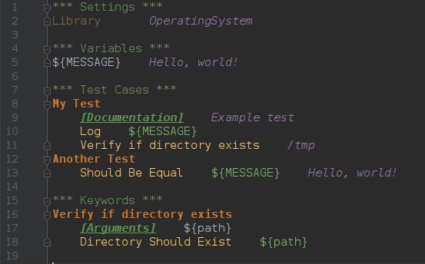
Robot Editors
Pycharm
Notes:
Najpierw pokazac npp i napisac prosty przykład a potem to samo w RIDE
zeby odpalić – w konsoli wpisac ride.py
http://robotframework.org/#tools

Slide 7
Links, installation
Python HAS to be installed!
Docs:
http://robotframework.org/robotframework/
installation:
pip install robotframework

Slide 8
Running
Starting from RobotFramework 3.1 onwards:
robot [options] <filename>.[robot, txt, html]
Remember to put [options] before filename – it’s won’t work otherwise!

Slide 9
Most common execution options
-t, --test <name>
Selects the test cases by name.
-i, --include <tag>
Selects the test cases by tag to be included to execution.
-e, --exclude <tag>
Selects the test cases by tag to be excluded from execution.
-v, --variable <name:value>
Sets individual variables.
-d, --outputdir <dir>
Defines where to create output files.
-L, --loglevel <level>
Sets the threshold level for logging. Optionally the default visible log level can be given separated with a colon (:).
--dryrun
In the dry run mode tests are run without executing keywords originating from test libraries. Useful for validating test data syntax
Notes:
Pokazac, kilka przykladow – szczególnie variable. Omowic tagi i w jaki sposób my używamy ich w nokii (branch, trunki, buildy itp.). Listenery będę omówione na koncy wykladu

Slide 10
Robot Framework
Basics and usage

Slide 11
Basic Example
HINT:
It is recommended to use four spaces between keywords and arguments.
Notes:
TERAZ RIDE + NOTEPAD + proste odpalenie
Inne formaty: HTML, TSV
Pipe and space separated format:
| *Setting* | *Value* |
| Library | OperatingSystem |
| *Variable* | *Value* |
| ${MESSAGE} | Hello, world! |
| *Test Case* | *Action* | *Argument* |
| My Test | [Documentation] | Example test |
| | Log | ${MESSAGE} |
| | My Keyword | /tmp |
| Another Test | Should Be Equal | ${MESSAGE} | Hello, world!
| *Keyword* |
| My Keyword | [Arguments] | ${path}
| | Directory Should Exist | ${path}

Slide 12
Settings in the Test Case table
[Documentation]
Used for specifying a test case documentation.
[Tags]
Used for tagging test cases.
[Setup], [Teardown]
Specify test setup and teardown.
Notes:
W settings tables sa jeszcze:
Force Tags, Default Tags
Test Setup, Test Teardown
Test Template
Test Timeout

Slide 13
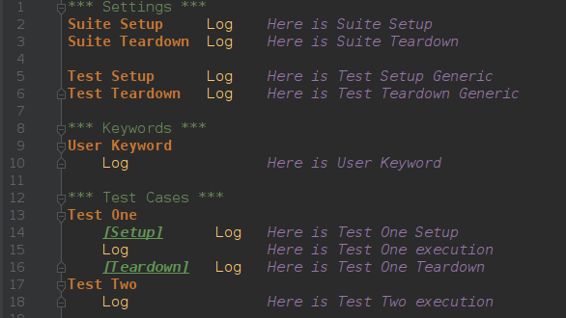
Setups and Teardowns
Notes:
Suite setup
Wykonywana przed testami. Jesli fail – wszystkie testy w tej sucie sa failowane (i nie wykonywane). Testy z niższych suit ani ich setup/teardown nie jest wykonywany. Potem od razu przechodzimy do teardown.
Suite teardown
Wykonywana po testach i testach niższych suit. Wykonywana ZAWSZE. Jeśli fail – wszystkie testy oznaczone jako fail w logach. Wykonywane sa wszystkie keywordy nawet jeśli ktorys failuje.
Test setup
Wykonywana przed keywordami w danym teście. Jeśli fail – keywordy nie sa wykonywane.
Test teardown
Wykonywana po uruchomionym teście bez względu na jego status i czy test setup failowal czy nie. Wszystkie keywordy sa wykonywane nawet jeśli ktorys failuje.
Keyword teardown
Keywordy uzytnikonika nie mogą mieć setupu. Keyword teardown wykonywana jest zawsze po uruchomieniu keywordy i bez względu na jego status. Odpalane sa wszystkie keywordy nawet jeśli poprzednie failuja.

Slide 14
Standard Libraries
BuiltIn
Collections
Dialogs
OperatingSystem
Process
ScreenShots
String
Telnet
XML
Notes:
BuildIn jest importowana zawsze. Reszte trzeba importować samemu

Slide 15
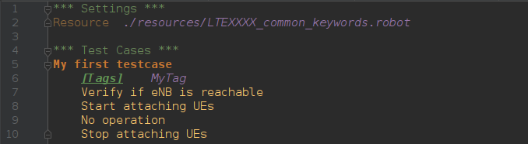
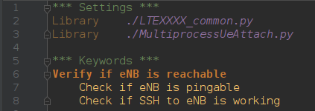
How to use libraries
LTEXXXX-A-a.robot
./resources/LTEXXXX_common_keywords.robot

Slide 16
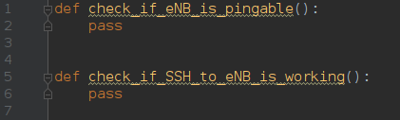
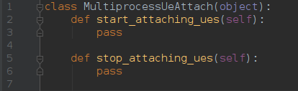
How to use libraries
./resources/LTEXXXX_common.py
./resources/MultiprocessUeAttach.py

Slide 17
Robot Framework
Variables

Slide 18
Variables
Robot Framework itself has three kinds of variables
${SCALAR}
@{LIST}
&{DICT}
In addition to this, environment variables can be used directly with the syntax %{VARIABLE}.
Notes:
Potencjalne pytanie:
Jak zapisać zmienna środowiskową do zmiennej Robota?
Specjalne zmienne:
${EMPTY} – pusty string
${TRUE} ${true}, ${FALSE}, ${false} – pythonowe True i False
Uzyc Evaluate i pokazac jak te typy widzi python

Slide 19
Special variables
Robot Framework has some special variables
${TRUE}
${FALSE}
${NONE}
${CURDIR}
${EMPTY}
In addition to this, environment variables can be used directly with the syntax %{VARIABLE}.
Notes:
Potencjalne pytanie:
Jak zapisać zmienna środowiskową do zmiennej Robota?
Specjalne zmienne:
${EMPTY} – pusty string
${TRUE} ${true}, ${FALSE}, ${false} – pythonowe True i False
Uzyc Evaluate i pokazac jak te typy widzi python

Slide 20
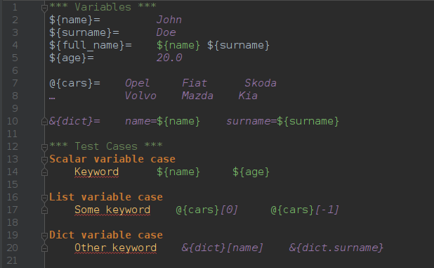
Creating variables
Notes:
Można ustawiac zmienne w keywordach ale NIE MOŻNA tego zrobić tak:
${zmienna}= ${wartocs}
TRZEBA uzyc Set variable:
${zmienaa}= Set variable ${wartość}
Uwaga na przekazywanie zmiennym do keywordow:
${age} - przekazane jako unicode
${${age}} - przekazane jako float
@{cars} - rozpakowuje argumenty
@{cars[0]} - error: '@{cars[0]}' is not list or list-like
@{cars}[0] - pierwszy element listy jako ‚unicode’: u’Opel’
${cars} - przekazane jako list
${cars[0]} - pierwszy element listy jako ‚unicode’: u’Opel’
${cars}[0] - przekazane jako unicode: u’ [u'Opel', u'Fiat', u'Skoda', u'Mazda'][0]’

Slide 21
Using ‚Set Test/Suite/Global Variable’ keywords from BuiltIn library
Set Test Variable
Variables set with Set Test Variable keyword are available everywhere within the scope of the currently executed test case.
Set Suite Variable
Variables set with Set Suite Variable keyword are available everywhere within the scope of the currently executed test suite
Set Global Variable
Variables set with Set Global Variable keyword are globally available in all test cases and suites executed after setting them.
Notes:
Jeżeli jakąś zmienną ustawimy jako Set Test Variable to jest ona widoczna w calym przypadku testowym. To znaczy, że jeżeli ustawimy taka zmienną w ktorymś z przygotowanych przez nas keywordow. Wówczas zmienna ta będzie dostępna we wszystkich keywordach uzywanych w tym tescie.
Inne przypadki testowe nie będą mialy dostepu do tej zmiennej
------
Jeżeli zmienna zostanie oznaczona jako Set Suite Variable wówczas będzie dostepna w calej suicie testowej nie powinno się naduzywac tego mechanizmu, ponieważ latwo popelnic blad który będzie trudny do wykrycia.
Zmienna oznaczona jako Set Suite Variable nie będzie widoczna w innych Test Suitach
------

Slide 22
Robot Framework
Keywords

Slide 23
Settings in keyword table
[Documentation]
Used for setting a user keyword documentation.
[Arguments]
Specifies user keyword arguments.
[Return]
Specifies user keyword return values.

Slide 24
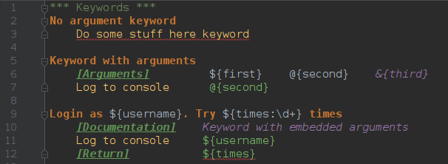
Creating user keywords
In many ways, the overall user keyword syntax is identical to the test case syntax.
Notes:
*** Keywords ***
No argument keyword
Do some stuff here keyword
Keyword with arguments
[Arguments] ${first} @{second} &{third}
Log to console @{second}
Login as ${username}. Try ${times:\d+} times
[Documentation] Keyword with embedded arguments
Log to console ${username}
[Return] ${times}

Slide 25
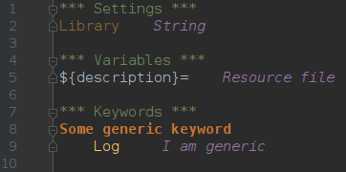
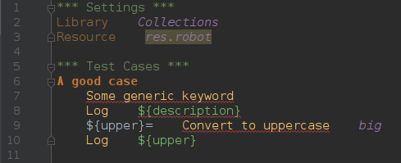
Resource files
Resource file cannot contain Test Case tables. Additionally, the Setting table in resource files can contain only import settings (Library, Resource, Variables) and Documentation. The Variable table and Keyword table are used exactly the same way as in test case files.
resource.robot
Tests.robot
Notes:
Potencjalne pytanie:
Czego nie może zawierać plik zasobów (Resource File)
Pokazac co się stanie jak resource file będzie miało zabroniona tabelke albo Setup w Settings

Slide 26
Robot Framework
User libraries

Slide 27
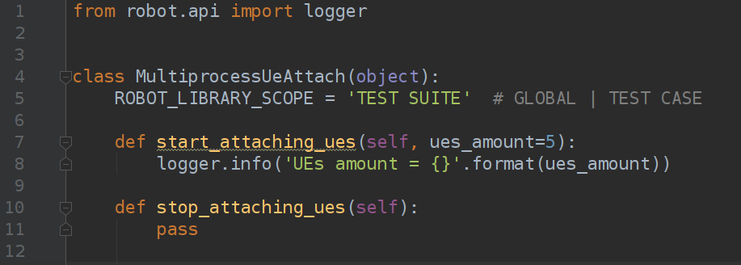
Custom libraries
Notes:
Callable które zaczynają się na ‚_’ nie sa importowane
Jeśli klasa ma taka sama nazwe jak plik to jest ok
Jeśli klasa ma inna nazwa niż plik trzeba inaczej importować np. plik myLib.py no to:
Library myLib.SuperMegaTimeClass
Można przeslac parametr do bibliotegki – pokazac jak
Jeszcze jest robot.api logger (nie można uzywac print bezpośrednio z kw wiec trzeba uzyc tego) – przykład pokazac
@keyword – liczy się kolejność argumentow a nie nazwa - sprawdzic

Slide 28
Library scope
TEST CASE
A new instance is created for every test case. A possible suite setup and suite teardown share yet another instance. This is the default.
TEST SUITE
A new instance is created for every test suite. The lowest-level test suites, created from test case files and containing test cases, have instances of their own, and higher-level suites all get their own instances for their possible setups and teardowns.
GLOBAL
Only one instance is created during the whole test execution and it is shared by all test cases and test suites. Libraries created from modules are always global.
Notes:
Napisac przykład z counterem (2 pliki robot z oddzielnymi testami to już 2 suity – można pokazac wpływ global

Slide 29
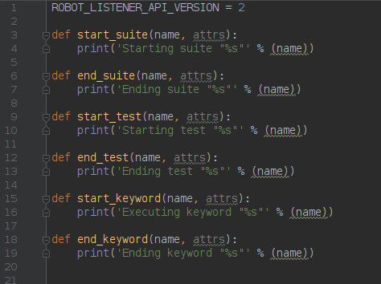
Listeners
Listeners receive information about test execution. Example usages include external test monitors, sending a mail message when a test fails, and communicating with other systems.
Notes:
--listener list.py dodaje listener do testu
--można dodac listenera do własnej biblioteki –np po to zeby po sobie sprzatala

Slide 30
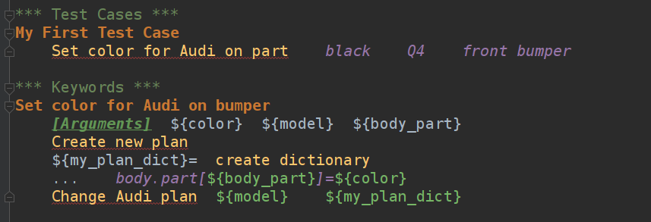
Refactoring
Let’s write a keyword that will change the attribute in our dream car:

Slide 31
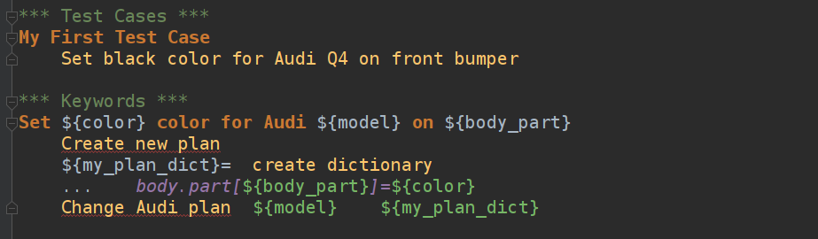
Refactoring
Let’s start with refactoring…
Looks better? But it’s still not the end... ;)

Slide 32
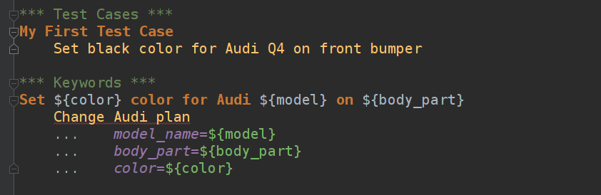
Refactoring
Let’s continue with refactoring…

Slide 33
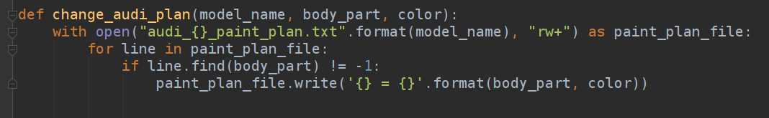
Refactoring
Let’s continue with refactoring…
Python file with actual implementation!

Slide 34
Coding (Testing) Standard

Slide 35
Tests structure
Test Cases are collected in Test Sets (Test Suites).
By one Test Set we understand one Robot Framework file.
One Test Set can contain one or more Test Cases.

Slide 36
Test Cases naming convention
TEST_NAME must be meaningful
TEST_NAME should distinguish test from others from the same test suite
TEST_NAME should be as short as possible
TEST_NAME should not have generic names like "scenario1", "failure_case2" etc.
TEST_NAME may be numbered*
*depends on testing level

Slide 37
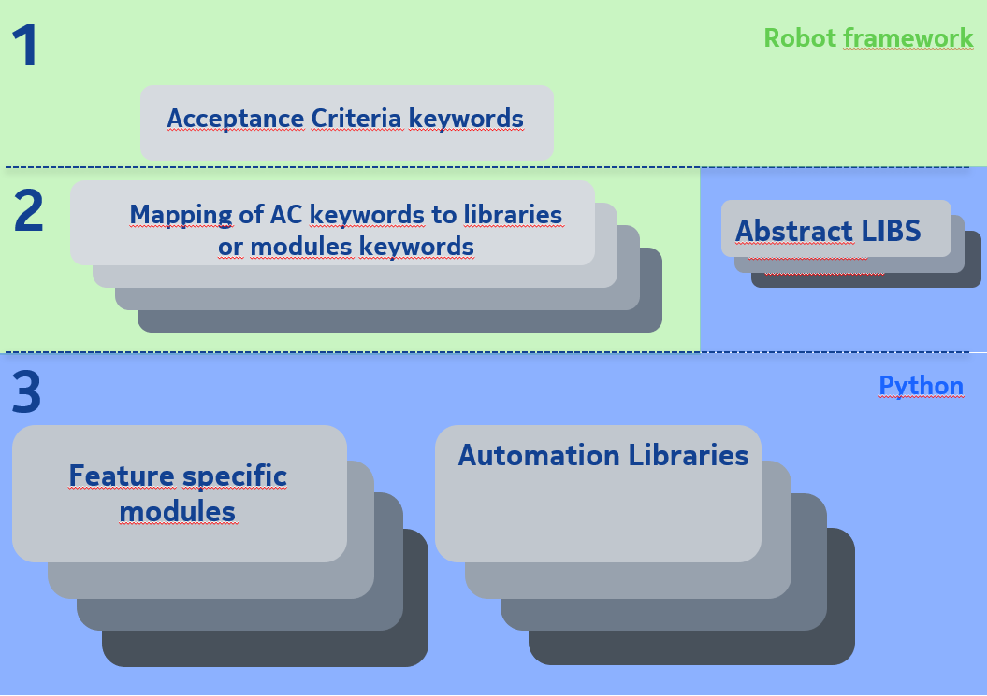
Test Automation Framework Layers Stack

Slide 38
Acceptance Criteria Keywords general convention (Layer 1)
<ACTION - verb> <WHAT - noun>
Verify if ...
Check if ...
Configure ...
Prepare configuration ...
Send configuration ...
Trigger <something> to <make some action>
Set <something> to <make some action>
*depends on testing level

Slide 39
Acceptance Criteria Keywords Guideline and examples (Layer 1)
Keywords should be written in English
Keywords should be written in project domain language - to be understandable by every engineer working in the project
Keywords should be fully meaningfull - they should do exactly and only this what is stated
Test responsibility should be highlited - It should be easily visible what exactly you are checking (by highlighting some keyword or using comments/documentation)
Unnecessary details should be hidden - tools/libs/modules/utils specific names should not be used here. Only project domain language.

Slide 40
Acceptance Criteria Keywords Guideline and examples (Layer 1)
Keywords should be as simple as possible - If it means that you should write more code (by adding another keyword in keywords section) do it!
Keywords should be as short as possible - but remember about all other rules that keywords should be self-documenting and meaningfull
Purposefully use AAA pattern - AAA means Arrange Act Assert:
Arrange – everything we need to prepare before we run our experiment
Act – Main part of the test, Action on object or method under test
Assert – essence of testing; Action that we cannot ommit – Assert that expected output/action occurred

Slide 41
Layer 2 Keywords Convention
Consist of other Robot Framework keywords or Python methods.
No strict rules are enforced like in previous layer - but take care about generic coding rules like readability and meaningfulness.
Take care of moving common Keywords to common shared Robot Framework files

Slide 42
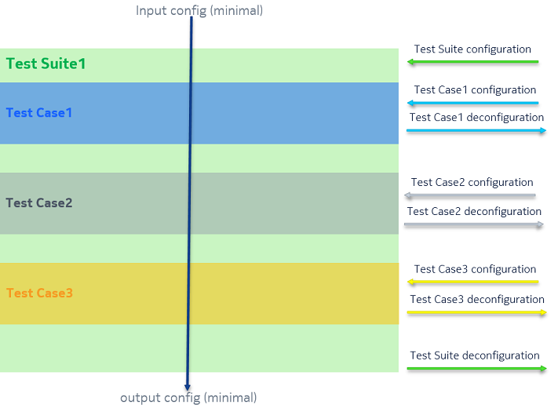
Configuration flow

Slide 43
Documentation
RobotFramework is descriptive language and it is considered as self-documenting language. This does not implicate lack of "documentation" section, which should have any other sufficient information and explanations for fully understanding of Test Case behavior.
"Documentation" section should not duplicate any information contained in keywords or inline comments.
Documenting workflow should be as follows:
Write self-documenting keywords
If something is not - use inline comments.
All other information should be contained in "Documentation" sections (Test Set documentation and Test Case documentation)

Slide 44
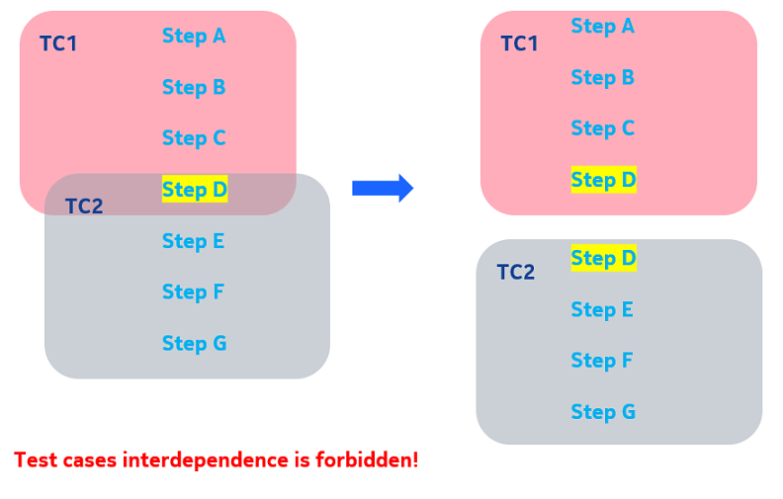
Tests interdependence (clean room testing)

Slide 45
Repository

Slide 46
Test repository structure
Repository must be structurized
Configuration file and keywords specific for particular functionality should be in the feature directory
DO NOT put any not relevant files to the test repository, e.g. binaries, logs, etc.

Slide 47
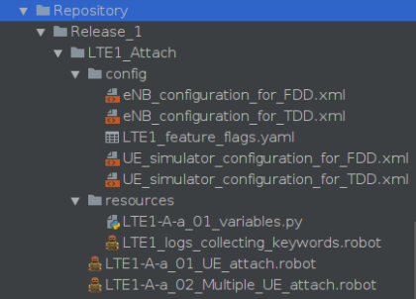
Test repository structure example

Slide 48
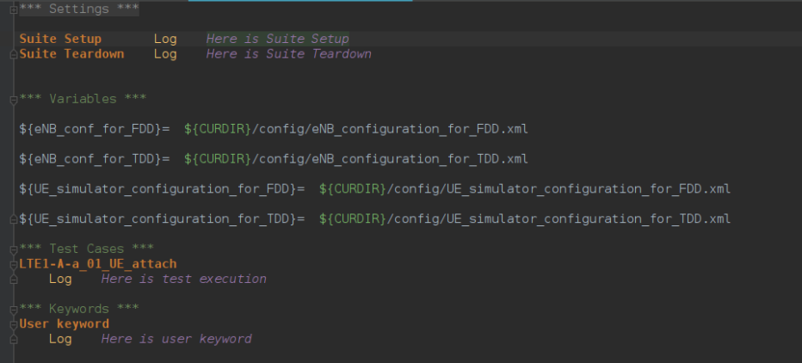
Configuration files – how to

Slide 49

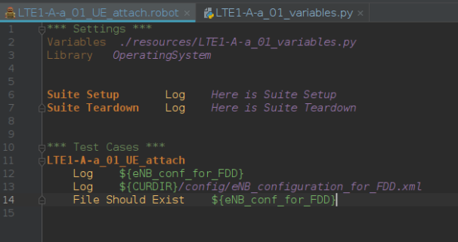
Configuration files – how to

Slide 50
Configuration files
Variables with paths to the config files should be in the *** Variables *** section
To avoid hardcoding absolute path, you can use variable ${CURDIR} and then
relative path from this place (directory with test) onwards
In case of relatively big numer of variables, they can be stored in separate file
and imported in *** Settings *** section

Slide 51
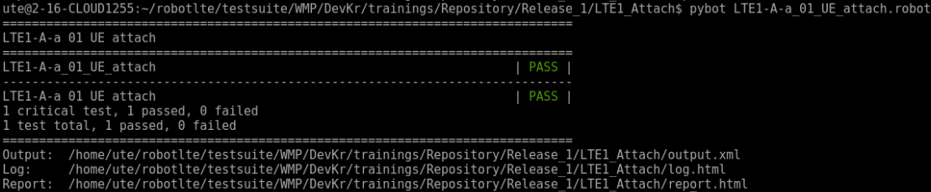
Test results – console output

Slide 52
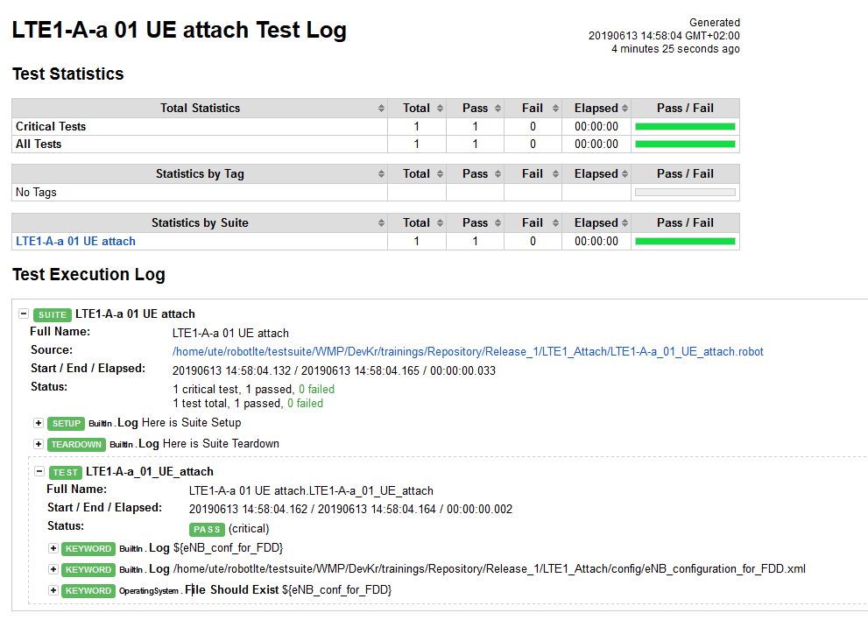
Test results - html

Slide 53
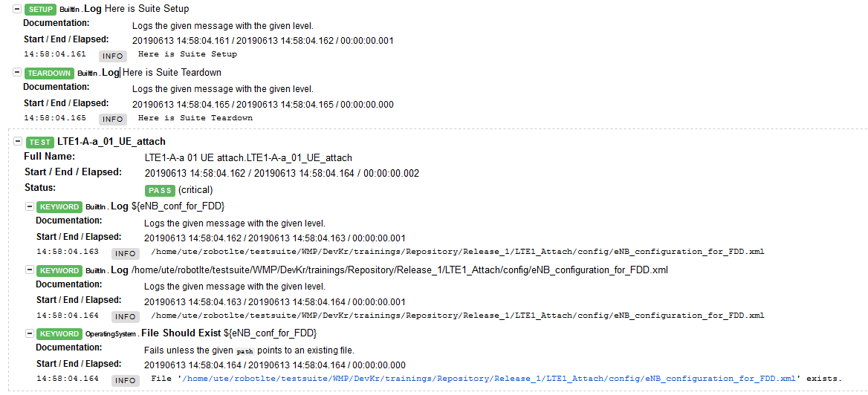
Test results - html

Slide 54
Imports
Keywords/functions specific for single Test Suite, should be in separate files
Keywords/functions common for multiple Test Suites, should be kept
in single – „common-like” file
DO NOT use cross-feature imports – extract it to external libraries
Generic keywords should be kept as libraries so they can we widely reused.

Slide 56
Copyright and confidentiality
The contents of this document are proprietary and confidential property of Nokia. This document is provided subject to confidentiality obligations of the applicable agreement(s).
This document is intended for use of Nokia’s customers and collaborators only for the purpose for which this document is submitted by Nokia. No part of this document may be reproduced or made available to the public or to any third party in any form or means without the prior written permission of Nokia. This document is to be used by properly trained professional personnel. Any use of the contents in this document is limited strictly to the use(s) specifically created in the applicable agreement(s) under which the document is submitted. The user of this document may voluntarily provide suggestions, comments or other feedback to Nokia in respect of the contents of this document ("Feedback"). Such Feedback may be used in Nokia products and related specifications or other documentation. Accordingly, if the user of this document gives Nokia Feedback on the contents of this document, Nokia may freely use, disclose, reproduce, license, distribute and otherwise commercialize the feedback in any Nokia product, technology, service, specification or other documentation.
Nokia operates a policy of ongoing development. Nokia reserves the right to make changes and improvements to any of the products and/or services described in this document or withdraw this document at any time without prior notice.
The contents of this document are provided "as is". Except as required by applicable law, no warranties of any kind, either express or implied, including, but not limited to, the implied warranties of merchantability and fitness for a particular purpose, are made in relation to the accuracy, reliability or contents of this document. NOKIA SHALL NOT BE RESPONSIBLE IN ANY EVENT FOR ERRORS IN THIS DOCUMENT or for any loss of data or income or any special, incidental, consequential, indirect or direct damages howsoever caused, that might arise from the use of this document or any contents of this document.
This document and the product(s) it describes are protected by copyright according to the applicable laws.
Nokia is a registered trademark of Nokia Corporation. Other product and company names mentioned herein may be trademarks or trade names of their respective owners.

Slide 57
Revision history and metadata
Please delete this slide if document is uncontrolled
Document ID: DXXXXXXXXX Document Location: Organization:
Version | Description of changes | Date | Author | Owner | Status | Reviewed by | Reviewed date | Approver | Approval date
v0.1 | Creation of document | 03-06-2019 | Paweł Nogieć | Paweł Nogieć | Done | Łukasz Gawor | 03-06-2019 | N/A | DD-MM-YYYY

